Slide 1


Slide 2


Slide 3


Poly means many (more than one) and phase means windings or circuits, each of them having single alternating voltage of the same magnitude and frequency
Poly Phase system: It is a combination of two or more than two voltages having same magnitude and frequency but displaced from one another by equal electrical angle or phase difference

Slide 4
  Poly phase System may be
  2 – phase system
  3 – phase system
  6 – phase system
  But all practical purposes, 3 – phase system is employed. Therefore, whenever a poly phase system is mentioned, we mean by that a 3 – phase system unless stated other wise

Slide 5
Introduction
The generator, transformer or rectifier have only one winding is called a single phase system
If the current or voltage follows a phase difference 180⁰ in a two windings , called two phase systems
If the phase difference is 120⁰ between voltages or currents in a three winding , called as Three phase systems

Slide 6
Advantages of Poly phase system
Constant Power: In single phase circuits, the power delivered is pulsating, Where as, in poly phase system power delivered is constant when loads are balanced
High Rating: The output of 3 – phase machine is nearly 1.5 times the output of single phase machine.
Power transmission Economics: to transmit the same amount of power over a fixed distance at given voltage, 3 phase system requires 75% of the weight of conducting material of that required by single phase system.
Superiority of 3 – phase induction motors:
3 –phase induction motors are self starting whereas 1 – phase induction motors have no starting torque without using auxiliary means.
Efficiency is high than single phase induction motor

Slide 7
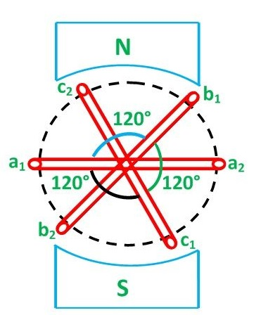
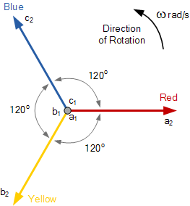
Generation of 3 – Phase System
Three-phase generators have three coils fixed at 120° to each other; thus three voltages, that are 120° out of phase with each other, are produced in three separate circuits. The phases are normally called red (R), yellow (Y) and blue (B) or line 1 (L₁), line 2 (L₂) and line 3 (L₃), or in the USA they are called A-phase, B-phase and C-phase.

Slide 8
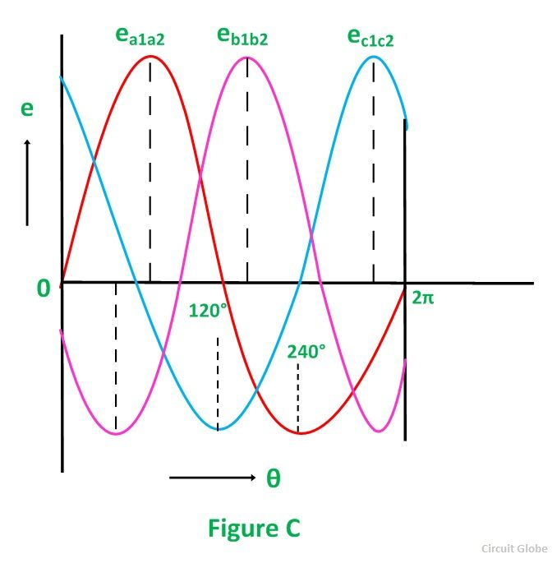
Generation of 3 – Phase System
Consider three identical coils a₁a₂, b₁b₂ and c₁c₂ as shown in the above figure. In this figure a₁, b₁ and c₁ are the starting terminals, whereas a₂, b₂ and c₂ are the finish terminals of the three coils. The phase difference of 120 degrees has to be maintained between the starts terminals a₁, b₁ and c₁.
Now, let the three coils mounted on the same axis and they are rotated by either keeping coil stationary and moving the magnetic field or vice versa in an anticlockwise direction at (ω) radians per seconds. Three EMFs are induced in the three coils respectively.

Slide 9
Generation of 3 – Phase System
Considering the figure C, the analysis about their magnitudes and directions are given as follows.
The emf induced in the coil a₁a₂ is zero and is increasing in the positive direction as shown by the waveform in the above figure C represented as e_{a1a2}.
The coil b₁b₂ is 120 degrees electrically behind the coil a₁a₂. The emf induced in this coil is negative and is becoming maximum negative as shown by the wave e_{b1b2}.
Similarly, the coil c₁c₂ is 120 degrees electrically behind the coil b₁b₂, or we can also say that the coil c₁c₂ is 240 degrees behind the coil a₁a₂. The emf induced in the coil is positive and is decreasing as shown in the figure C represented by the waveform e_{c1c2}.

Slide 10
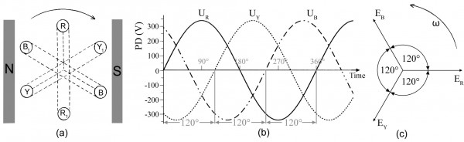
Generation of 3 – Phase System

Slide 11
Naming the Phases
The three phase system may be named by
Numbers (1,2 and 3);
By letters (a, b and c) or
By colors (Red, Yellow and Blue i.e. R Y B)
In India we used phase sequence of colors (R Y B)

Slide 12
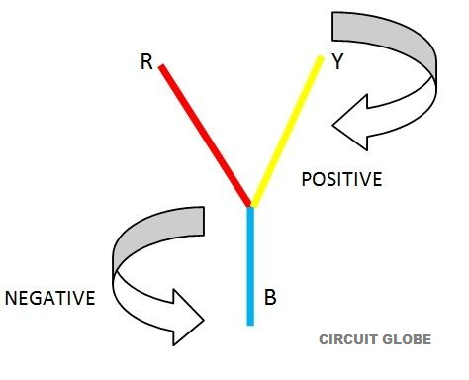
Phase Sequence
The order in which the voltages (e.m.fs) in the three phases attain their maximum positive value is called the phase sequence.
Phase sequence may be positive or negative
If the phases of any coil are named as R, Y, B then the Positive phase sequence will be RYB, YBR, BRY also called as clockwise sequence and similarly the Negative phase sequence will be RBY, BYR, YRB respectively and known as an anti-clockwise sequence.

Slide 13
Importance of Phase sequence
Direction of rotation of 3 – phase induction motors depends upon the phase sequence
Parallel operation of 3 –phase generators and transformers is only possible if phase sequence is known

Slide 14
Interconnection of 3 – phase system
There are two methods are adopted for interconnecting the three phases for saving of copper. :
Star or Wye (Y) Connection ( 3 phase 4 wire Connection)
Mesh or Delta connection (Δ) ( 3 Phase 3 Wire Connection)
If three armature coils of the 3-phase alternator are not interconnected, each phase or circuit would need two conductors.

Slide 15
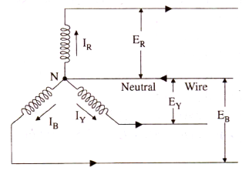
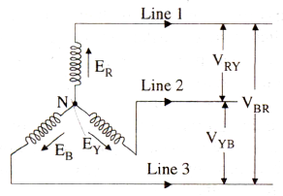
Star Connection
The point ‘N’ is known as star point or
neutral point
If this three-phase voltage is applied across
a balanced symmetrical load, the neutral wire will be carrying three currents which are exactly equal in magnitude but are 120º out of phase with each other.
The voltage induced in each winding is called the ‘phase’ voltage and current in each winding is known as ‘phase’ current.

Slide 16
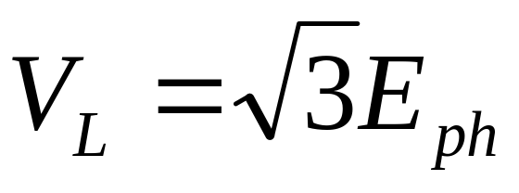
Line Voltage and Phase Voltage
E_{R} = E_{Y} = E_{B} = E_{ph} (phase Voltage in magnitude)
V_{RY} = V_{YB} = V_{BR} = V_{L} (Line voltage in magnitude)

Slide 17
Line current and Phase Current
Current in line 1 = I_{R}
Current in line 2 = I_{Y}
Current in line 3 = I_{B}
Since I_{R} = I_{Y} = I_{B} = I_{L}
I_{ph} - the phase current
I_{L} = Line current
I_{L} = I_{ph}

Slide 18




Power
The total power in the circuit is the sum of the three phase powers. Hence
Total Power =3 x phase power

Slide 19
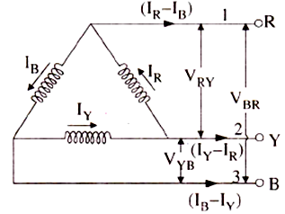
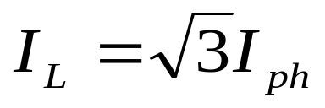
Delta Connection
Current in line 1 is I₁ = I_{R} – I_{B}
Current in line 2 is I₂ = I_{Y} – I_{R}
Current in line 3 is I₃ = I_{B} – I_{Y}
I_{B} = I_{R} = I_{Y} = I_{ph} (phase current) in magnitude)
V_{RY} =V_{YB} = V_{BR} = line voltage
Line voltage = phase voltage
V_{L} = E_{ph}

Slide 20

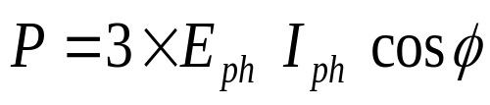
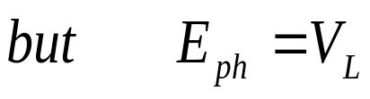
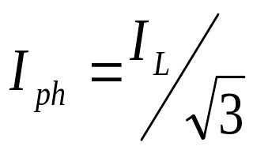
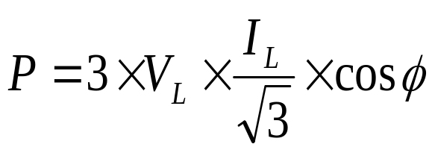
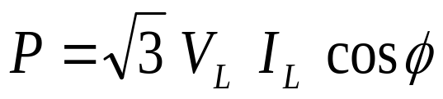
Power:

Slide 21
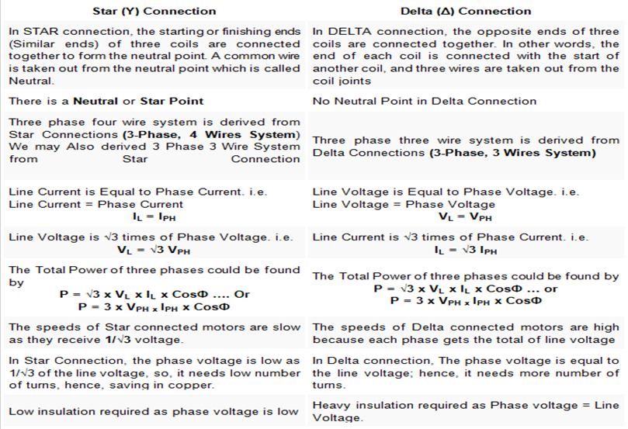
Comparison between Star and Delta Connection

Slide 22



Slide 23


